Slide 1
9. Typology of negation
ENG 452: Linguistic Typology

Slide 2
1. Introduction
We will briefly discuss the most common ways in which negative sentences may be formed.
To begin with, we need to be able to distinguish negative sentences from positive sentences.

Slide 3
What is meant by negation?
Negation is a fundamental linguistic device that we use every day to express various negative expressions.
For instance, we employ it:
to contradict the truth of a proposition (“It is not raining” contradicts “It is raining”),
express denial/rejection (“I will not go there” denies a question “Will you go there?”),
express the non-existence of entities (“There is no apple in the basket”),
express prohibition (“You should not go there.”), and
express even affirmation or positivity with a negative expression (“It is not that he doesn’t eat ice cream” meaning to say he does eat ice cream) and so on.

Slide 4
In a way, negation can be seen as a process that transforms an affirmative sentence into a negative one.
Lyons (1977), for instance, defines negation as a denial of a positive proposition or a predication that a proposition is untrue.
Such is the importance of negation that affirmative and negative expressions are like two sides of the same coin.

Slide 5
2. Negation as a Universal Category
All human communication systems contain a representation of negation.
It is one of the most important aspects of the human communication system.
No animal communication system contains negative utterances.
So, negation is a universal grammatical category present in all natural languages of the world, and every language has its own rules for marking negation and ways to use it.

Slide 6
Negation is a universal phenomenon that occurs in all natural languages.
It is a simple syntactic operation by which speakers negate (or deny) a certain proposition expressed by the sentence.
But how languages express negation varies across languages.
This can be done in a number of ways, in different languages.
Most of the languages employ `negative words' to express negation

Slide 7
3. Negation typology: Negation and their order in Languages of the world
Recall the six logically possible orders of the three clausal elements subject, object, and verb:
SOV, SVO, VSO, VOS, OVS, and OSV.

Slide 8
Six logically possible word orders in languages*
(1) Korean (SOV)
kiho-ka saca-lil cha-ass-ta
Keeho-NOM lion-ACC kick-PST-IND
'Keeho kicked the/a lion.'
(2) Thai (SVO)
khon nii kat maa tua nan
man this bite dog CL that
'This man bit that dog.’
(3) Welsh (VSO)
Lladdodd draig ddyn
killed dragon man
'A dragon killed a man.’
[* this word order is repeated from the previous lecture (1)]
(4) Malagasy (VOS)
manasa ny lamba ny vehivavy
wash the clothes the woman
'The woman is washing the clothes.’
(5) Panare (OVS)
piʔ kokampö unkiʔ
child washes woman
'The woman washes the child.'
(6) Nadeb (OSV)
samũ̀ũ̀y yi qa-wũ̀h
howler-monkey people eat
'People eat howler-monkeys.'

Slide 9
Depending on the language, negation can have different positions with regard to the Subject, Verb, and Object.
We will just see the position of negation in SOV, SVO, and VSO (verb-initial languages).
Then, we will see in detail how negation occurs in Hindi.

Slide 10
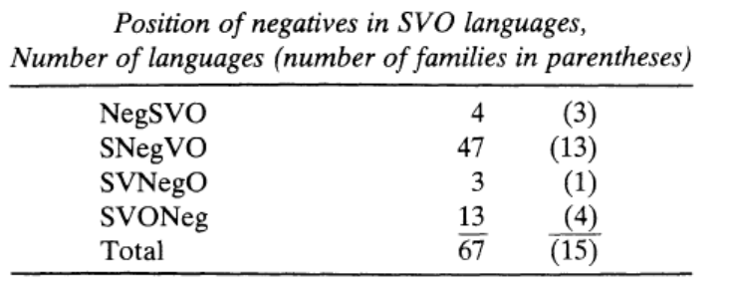
The four subtypes of SVO languages are: NegSVO, SNegVO, SVNegO, and SVONeg. All four of these possibilities exist, as shown in Table 1.

Slide 11
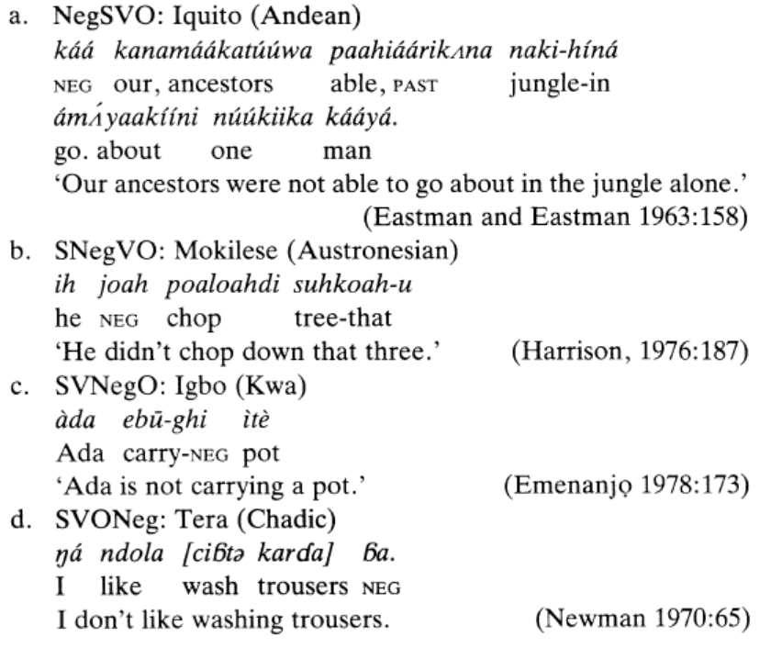

Slide 12
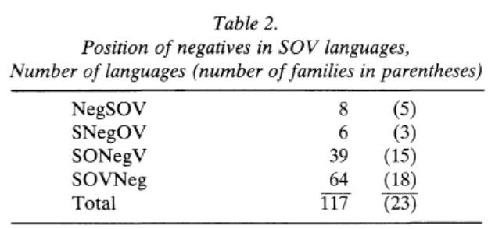
Among SOV languages, there are again four possible subtypes, Neg-SOV, SNegOV, SONegV, and SOVNeg. Again, all four of these subtypes exist, as shown in Table 2.

Slide 13
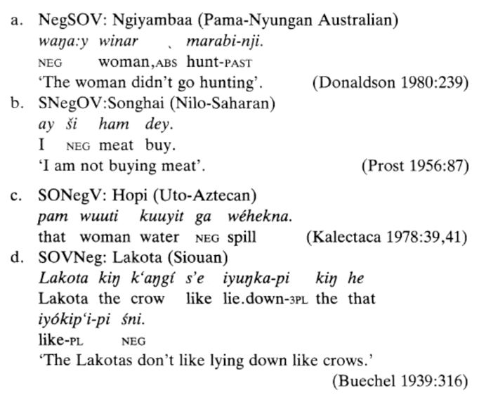

Slide 14
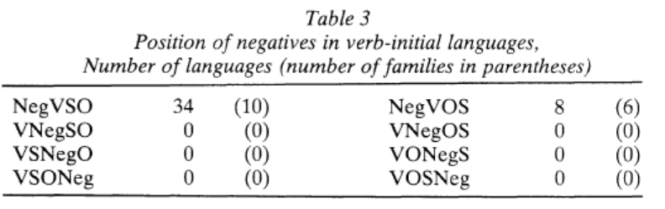
The pattern among verb-initial languages is somewhat different from that among SVO and SOV languages, in that the full range of logical possibilities is not attested. As shown in Table 3, all of the VSO languages in my sample are NegVSO, and all of the VOS languages are NegVOS.
The data in Table 3 suggests the following universal:
(1) If a language is verb-initial, then the negative will precede the verb.

Slide 15
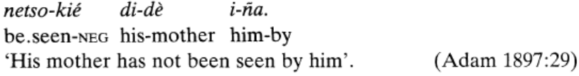
However, this universal is not always true, as some languages have Neg after the verb.
Eg. Cariri, an Equatorial language formerly spoken in Brazil, the negative follows the verb.
Thus, the universal in (1) is thus not exceptionless, but it is a strong statistical universal,

Slide 16
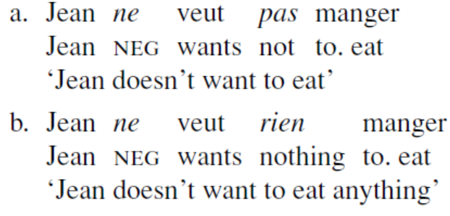
Some languages negation is regularly expressed by a pair of negative words. This is true, for example, of standard French, where negation requires the negative clitic ne plus some other negative word

Slide 17
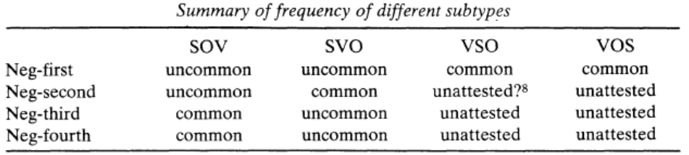
We can summarise the order of negation as
SOV languages are most commonly either SOV-Neg or SONegV,
SVO languages are most commonly SNegVO, and
V-initial languages are overwhelmingly NegV (i.e. NegVSO or NegVOS).

Slide 18
4. Negation in Hindi
Negation in Hindi is expressed through three negation markers: nahiiN, na, and mat.
Of these three, nahiiN is used most frequently.
We will discuss the occurrence of all three elements of negation.

Slide 19
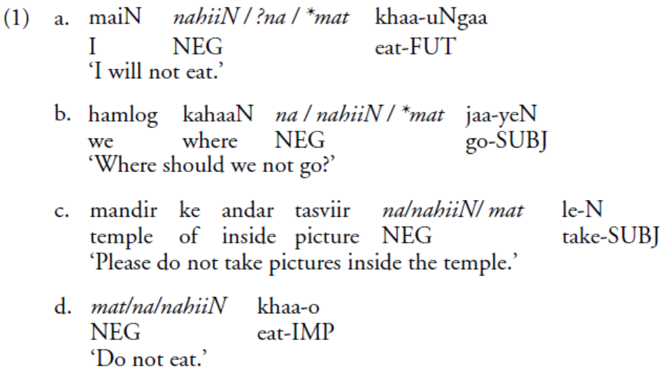
Hindi
It is important to mention here that nahiiN can be used in most of the cases.
However, the use of the other two negatives, namely na and mat, is restricted.

Slide 20
Na is used in Subjunctive and Imperative cases, as in 1b and 1d,

Slide 21
Whereas the use of mat is restricted to Imperative sentences, as shown in 1d.
Example 1c shows that mat can also be used in Subjunctive contexts.
This is because the Subjunctive example in 1c is equally good as an Imperative.
If a Subjunctive sentence can be interpreted as a request or command, then the use of mat in such cases is allowed.
If the interpretation of the Subjunctive sentence is not a request or command, then the use of mat is not permitted, as shown in 1b.
The ungrammatical use of na in 1a as opposed to 1 (b–d) shows that it is restricted to Subjunctive and Imperative sentences only.
However, the use of na is the preferred choice only in the Subjunctive.

Slide 22
Mat
The most straightforward of the Hindi-Urdu negative particles is mat.
Mat is used only for the imperative, particularly in an emphatic or non-honorific prohibition.
It occurs only in negative commands.
In his Negation in South Asian Languages, Bhatia describes mat as the particle used with the “non-honorific” imperative (1995: 12).
Others simply describe mat as more emphatic, or “stronger.”
As the “stronger negative,” mat may be used with a typically formal or neutral imperative “to emphasize the negation or to warn the person”
That mat is one of the three negative particles and it is restricted to the negative imperative is sufficient.
tuu mat jaa
you NEG go (IMP)
“Don’t go!” (Bhatia 1995: 13)

Slide 23
Na
The second most-restricted negative particle in Hindi-Urdu is na.
na is restricted to tag questions, disjunctive constructions, and non-indicative clauses – subjunctive, imperative, non-finite forms
According to Bhatia’s classification, na occurs with non-indicative verb forms: conditional, participial, and gerundive phrases, subjunctive, and honorific imperative (Bhatia 1995: 12).
Masica notes that na is always used in the negation of non-finite.
na is also the form used in tag questions (“isn’t it?”) in Hindi-Urdu (1.2.2.h) (Masica 1991: 389).

Slide 24
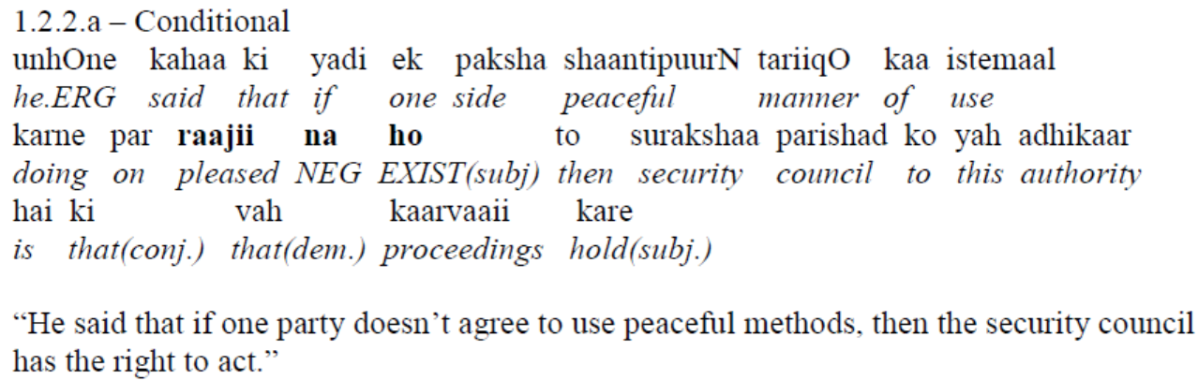
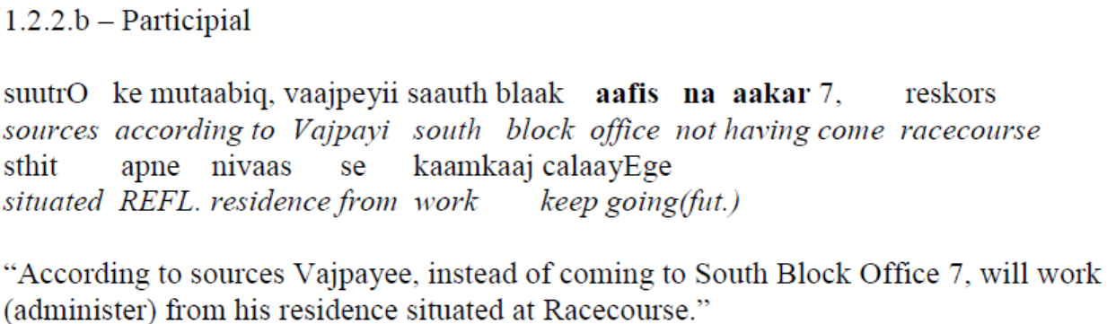
t

Slide 25
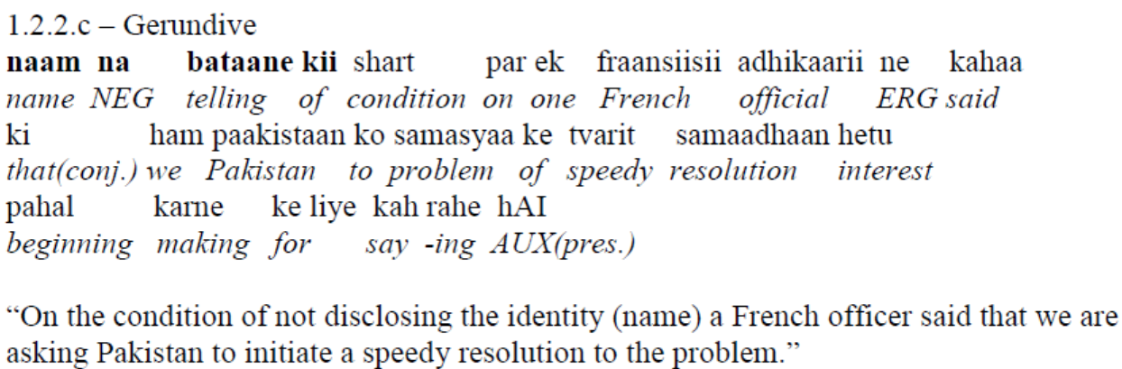
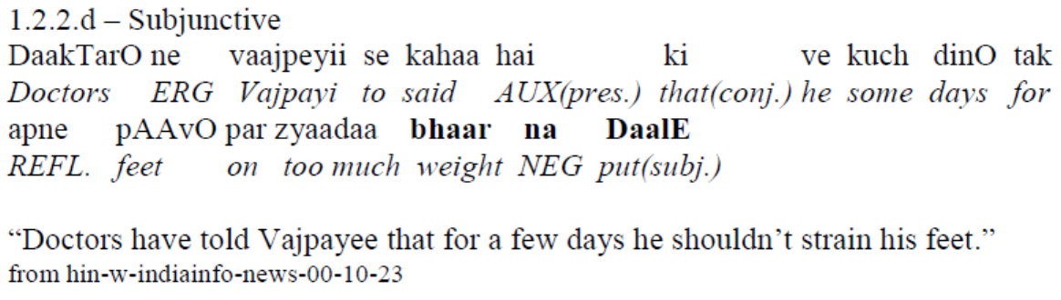
The

Slide 26
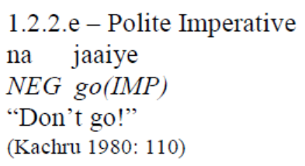
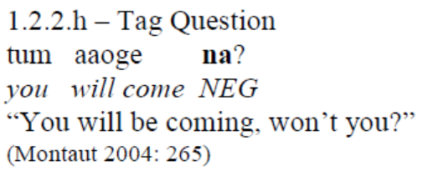
The

Slide 27
Nahii
The least-restricted of the negative particles in Hindi-Urdu is nahii.
It is used primarily for negating finite and indicative verb forms (Montaut 2004: 260), but, as noted, may be used in other contexts as well.
nahii is used most frequently.
nahii is the general negator, traditionally associated with the indicative;

Slide 28
So far, we see the position of negation with regard to the verb in Hindi as:
NegV (Negation Verb order)
We will now see the distribution of negative markers in sentences,
and the implications of the occurrence of negative markers in different positions in the Hindi sentence.

Slide 29
Two types of negation:
Languages usually distinguish between two types of negation, viz., constituent negation and sentential negation.
The difference between these two is mainly due to the scope of the negative operator.
If the whole proposition falls within the scope of the negative element, then it is sentential negation.
But if only a constituent within a clause falls within the scope of negation, then it is constituent negation.

Slide 30
Constituent and Sentential negation in Hindi*
There are several positions in a sentence where a negative marker can occur.
The immediately pre-verbal position of negation is associated with sentential negation.
A negative marker in any other position marks constituent negation (Bhatia, 1978).
*from Kumar (2006)

Slide 31
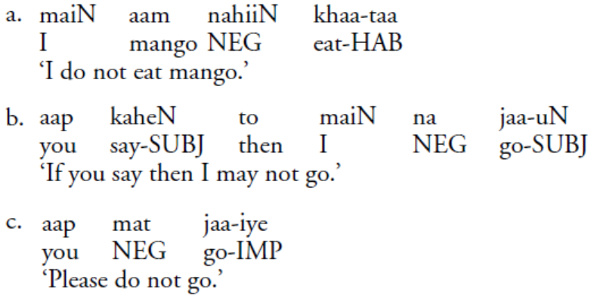
Pre-verbal (Sentential) Negation
The occurrence of negative elements in the pre-verbal position marks sentential negation in the unmarked word order in Hindi (discussed in Bhatia (1978). Examples from Kumar (2006)
(2)
all the negative markers are in the immediately pre-verbal position.
A negative marker in such a position takes scope over the entire sentence.

Slide 32
4.2 Constituent Negation
In the Hindi sentence, a negative marker may also occur in a position other than the immediately pre-verbal.
Such a phenomenon, when the negative marker does not immediately precede the verb, is called constituent negation.
This description of constituent negation is based on both the linear order of the negation marker and other constituents in a sentence, as well as the interpretation of a sentence.

Slide 33
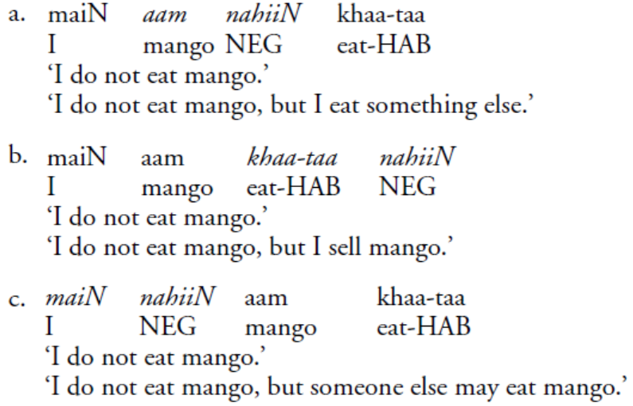
Consider the examples
(3)

Slide 34
In 3a, the negation marker is in the pre-verbal position; however, if it is associated with the object aam ‘mango,’ then it negates only the object NP and does not remain a sentential negative anymore.
In 3b, the negation marker follows the verb, and in this position, the negation marker negates only the verb.
In 3c, the negation marker follows the subject NP, and it negates only the subject NP.
Finally, we can say that the order of constituent negation in Hindi is XP-final (i.e. XP-nahiiN),
while sentential negation seems to precede the verb only.

Slide 35
Thus, if a negative marker is in the immediately pre-verbal position, it expresses sentential negation, while in other positions negation markers indicate constituent negation.
In the case of sentential negation, the entire sentence is in the scope of the negative,
whereas in the case of constituent negation only a particular constituent (what is followed by the
negative) is in the scope of the negative.

Slide 36
5. Negative Polarity Items (NPIs)
There are some words that occur only in the presence of a negation in a sentence.
Such words are known as Negative Polarity Items (NPIs).
So, a negative polarity item is an expression that is restricted to negative contexts and some other semantically related contexts such as questions and conditional clauses although its semantic properties would seem to allow occurrence in positive contexts as well.

Slide 37
Common NPIs in English:
Here are some classic examples of NPIs in English:
NPI Example Sentence
any I don’t have any money.
ever Have you ever been to Japan?
at all She didn't help at all.
yet He hasn't arrived yet.
Anyone I did not see anyone
More examples: Anyone, anything, even a penny, even once, ‘Even a single,

Slide 38
Negation must license the NPI
NPIs obligatorily require the presence of a negation marker in order to be licensed in a sentence.
That means negation licenses the occurrence of an NPI in a sentence.
Negation is the licensor, and NPI is the licensee.
Without negation, the occurrence of NPI in a sentence is ungrammatical.
NPI need a clause-mate negation
Means negation and NPI must be in the same clause (not in a different clause)

Slide 39
NPIs are licensed by the presence of a clause mate sentential negation
If negation does not license them, the NPIs cannot occur in a sentence.
In other words, NPIs are ungrammatical in positive contexts: Eg.
* ‘Anyone ate the fruit.’
* ‘There is anything.’
* ‘Even a single person came.’
* ‘I see anything.’
* ‘John call anybody.’
* ‘You give me even a penny.’
* ‘Mary go anywhere.’
* ‘Mary keep anywhere.’
*‘John went to the field even once.’ *I called anyone
*I have any money. *She helped at all.
These are ungrammatical because NPIs need triggers like negation, questions, conditional clauses, and Modal sentences.

Slide 40
Negation must C-Command the NPI
The negation marker c-commands the NPI in order to license the NPI in a sentence.
In order to c-command the NPI, the negative marker must precede the NPI in a linear order
or negation must occur higher in the structure (structural representation of the sentence).
*‘Anyone did not eat the fruit.’
* ‘Anyone did not eat anything.’

Slide 41
NPIs in Hindi
In Hindi, words like:
koi bhii ‘any’
Kisii bhii ‘any,’
ek bhii ‘even one,’ and
kabhii ‘never,’
are NPIs as they require a negative licensor.
Meaning they occur only in a negative environment.
Also expressions such as abhii tak ‘until now,’ ek phuuTii kauRii ‘a red cent,’
which are idiomatic expressions in their common usage are also like NPIs in nature, as they require a
negative licensor.

Slide 42
NPIs are composed of an indefinite and the particle bhii ‘also/even,’ often called an emphatic particle in traditional grammars (Bhatia 1978, Mahajan 1990a, and Lahiri 1998).
Some of the items that can be combined with bhii ‘also/even’ (in a non-NPI context the emphatic particle bhii is equivalent to the English expression also) are listed below.
ek ‘one’ + bhii ‘also/even’ = ek bhii ‘even one/any’
koi ‘some’ + bhii ‘also/even’ = koi bhii ‘any’
kisii ‘some’ + bhii ‘also/even’ = kisii bhii ‘any’
kuch ‘something’ + bhii ‘also/even’ = kuch bhii ‘anything’
kabhii ‘sometime’ + bhii ‘also/even’ = kabhii bhii ‘anytime’

Slide 43
The following NPIs do not require negation markers in certain contexts, such as questions, modals, conditionals, and adversative predicates.
koi bhii ‘anybody’
kisii bhii ‘anybody’
kuch bhii ‘anything’

Slide 44
NPIs with Clause Mate Negative Licensor
The NPIs below appear in the presence of a clause mate sentential negation. Consider the following examples:
(1a) us kamre mein ek bhii student nahii thaa
that room in one even student NEG was
‘There wasn’t any student in that room.’
(1b) * us kamre mein ek bhii student thaa
that room in one even student was
* ‘There was any student in that room.’

Slide 45
(2a) main-ne kisii bhii student ko nahii dekh-aa
I-ERG some even student to NEG see-PERF
‘I did not see any student.’
(2b) * main-ne kisii bhii student ko dekh-aa
I-ERG some even student to see-PERF
* ‘I saw any student.’

Slide 46
(3a) main-ne kuch bhii nahii khaa-yaa
I-ERG something even NEG eat-PERF
‘I did not eat anything.’
(3b) *main-ne kuch bhii khaa-yaa
I-ERG something even eat-PERF
*‘I did not eat anything.’

Slide 47
NPIs in non-negative contexts
There are some other contexts where NPIs can be permitted, even in the absence of a clause mate negation. Some of these contexts are questions, conditionals, modals, adversative predicates, generics, and some cases of imperatives (Lahiri 1998).
NPIs in other languages, such as English, are also permitted in such contexts (see Ladusaw 1979 and Linebarger 1980).
We will only consider some of the NPIs in Hindi that are permitted in the absence of a negative licensor.

Slide 48
NPIs in the Context of Questions
NPIs such as ek bhii ‘even one/any’ , koi bhii ‘any’, kisii bhii ‘any’, kuch bhii, and abhii tak ‘so far’ are permitted in the context of a question interpretation
(1) us kamre mein ek bhii student thaa (kyaa)
that room in one even student was what
‘Was there even one/any student in that room?’
(2) us kamre mein koi bhii student thaa (kyaa)
that room in some even student was what
‘Was there even any student in that room?’
(3) aap-ne kisii bhii student ko dekh-aa (kyaa)
you-ERG some even student to see-PERF what
‘Did you see any student?’
(4) aap-ne kuch bhii khaa-yaa (kyaa)
you-ERG something even eat-PERF what
‘Did you eat anything?’

Slide 49
NPIs in the Context of Conditionals
NPIs such as ek bhii ‘even one/any’, koi bhii ‘any’, kisii bhii ‘any’, and kuch bhii ‘anything’ are permitted in the context of conditional interpretation.
(1) (agar) us kamre mein ek bhii student aa-taa hai to main aap ko bataa-ungaa
if that room in one even student come-HAB is then I you to tell-FUT
‘I will let you know if even one student comes to that room.’
(2) (agar) aap-ne kuch bhii khaa-yaa to main sab ko bataa-ungaa
if you-ERG something even eat-PERF then I everybody to tell-FUT
‘If you eat anything, I will tell everybody.’

Slide 50
NPIs in the Context of Modals
NPIs such as ek bhii ‘even one/any’ , koi bhii ‘any’, kisii bhii ‘any’ , and kuch bhii ‘anything’ are permitted in the context of a modal.
(1) us kamre mein koi bhii student baith sak-taa hai
that room in someone even student sit MOD-HAB is
‘Any student can sit in that room.’
(2) main kisii bhii student se mil sak-taa huung
I someone even student with meet MOD-HAB am
‘I can meet with any student.’
(3) aap kuch bhii khaa sak-te hai
you anything even eat MOD-HAB are
‘You can eat anything.’

Slide 51
NPIs in the Context of Adversative Predicates
NPIs like ek bhii ‘even one/any’, koi bhii ‘any’, kisii bhii ‘any’, and kuch bhii ‘anything’ are permitted in the context of an adversative predicate
(1) mujhe aascarya hai ki kal aap-ne kuch bhii khaa-yaa
I-DAT surprise is that yesterday you-ERG something even eat-PERF
‘I am surprised that you ate anything.’

Slide 52
References
Dryer, Matthew. 1988. Universals of negative position. In M. Hammond, E. Moravcsik and
J. R. Wirth (eds), Studies in Syntactic Typology. Typological Studies in language 17. Amsterdam: John
Benjamins. (93-124).
Kumar, Rajesh (2006). Negation And Licensing of Negative Polarity Items In Hindi Syntax. Routledge

